Slide 1

Basic AI concept in Unity game

Slide 2
Learning Objectives
Understand the concept of AI in games
Apply AI techniques to create intelligent NPCs
Implement basic AI behaviors like patrolling, chasing, and attacking.
Utilize Finite State Machines (FSMs) to control NPC behavior.

Slide 3
Artificial Intelligence in Games
The concept of intelligence can be interpreted in many ways: psychological, scientific, philosophical, spiritual, sociological, and more. Many of these interpretations are profound. However, in video games, it's primarily about appearances - the appearance of intelligence. Perhaps this is why the term "artificial" enters the title.
The idea is that video games are primarily about having fun and engaging experiences. This means that the believability of a game for the player rests on how engaged they are with the events actually happening in the game.

Slide 4
Artificial Intelligence in Games
Key Use Cases of AI in Games
Realistic NPC Behavior: AI enables NPCs to behave more realistically, making them more engaging and believable.
Adaptive Difficulty: AI can adjust the difficulty of the game based on the player's skill level.
Emergent Behavior: AI can lead to unexpected and interesting behaviors that can surprise and delight players.
Procedural Content Generation: AI can generate game content, such as levels, quests, and items, reducing development time and increasing replayability.

Slide 5
Enemy AI: Making it Believable
Key Use Cases of AI in Games (cont.)
Strategic Decision-Making: AI can make strategic decisions in real-time, such as planning attacks, setting traps, or outmaneuvering the player.
Natural Language Processing: AI can enable players to interact with NPCs using natural language, creating more immersive and personalized experiences.
Machine Learning: AI can learn from player behavior and adapt its strategies accordingly, leading to more challenging and rewarding gameplay.

Slide 6
Enemy AI: Making it Believable
Examples of AI in Games
Open-World Games: AI-controlled NPCs can populate the world, creating dynamic and immersive environments.
Real-Time Strategy Games: AI opponents can devise complex strategies and adapt to the player's tactics.
Role-Playing Games: AI can control the behavior of enemies, allies, and non-player characters.
Sports Games: AI can simulate realistic player movements and strategies.

Slide 7
Enemy AI: Making it Believable
Imagine a non-player character (NPC), like an enemy wizard in an RPG, doing something nonsensical (like walking through solid walls for no reason or aimlessly walking back and forth). This "mistake" or "silliness" disrupts the player's immersion and reminds them it's just a game.
Therefore, for games, AI largely consists of making characters respond appropriately to their situations, especially when the player is looking. In games where AI is for enemies or opponents, it's usually about tweaking difficulty - not making the AI too easy or too hard.

Slide 8
Enemy AI: Making it Believable
Creating Enemy AI with Unity's FSM
This section will guide you through creating a basic enemy AI using Unity's Finite State Machine (FSM) system. We'll focus on building an enemy that can:
Search the environment (patrol)
Chase the player
Attack the player
Flee and search for health power-ups (if injured)

Slide 9
Enemy AI: Making it Believable
Creating Enemy AI with Unity's FSM
This section will guide you through creating a basic enemy AI using Unity's Finite State Machine (FSM) system. We'll focus on building an enemy that can:
Search the environment (patrol)
Chase the player
Attack the player
Flee and search for health power-ups (if injured)

Slide 10
Enemy AI: Making it Believable
FSM for Enemy Behavior
By observing the enemy character, we can identify a set of behaviors:
Idle: The enemy starts the scene standing still.
Patrol: The enemy wanders around, searching for the player.
Chase: If the enemy sees the player, they chase them.
Attack: When the player comes into attack range, the enemy attacks.
Flee: If the enemy takes significant damage, they flee and search for a health power-up.
The enemy can only be in one state at a time, and each state determines how the enemy behaves. We can use an FSM design pattern to manage these states and transitions between them.

Slide 11
Enemy AI: Making it Believable
Building the FSM in Mecanim
Mecanim is Unity's animation system. We'll create an FSM within Mecanim to control the animations associated with each enemy state:
Idle: Idle animation
Patrol: Walk animation
Chase/Flee: Run animation
Attack: Jump animation (for this example)
We'll also define transitions between these states based on triggers like "Patrol," "Chase," "Attack," and "SeekHealth."

Slide 12
Enemy AI: Making it Believable
Building the FSM in Mecanim
Implementing the FSM in C#
We'll create a C# script (AI_Enemy.cs) to manage the enemy's behavior and interact with the Mecanim FSM. This script will:
Define an enumeration for enemy states (Idle, Patrol, Chase, etc.)
Maintain a variable for the current enemy state
Implement Coroutines for each state (Idle, Patrol, Chase, etc.)
Use triggers to transition between states in Mecanim
Check for player visibility and health levels to trigger state changes

Slide 13
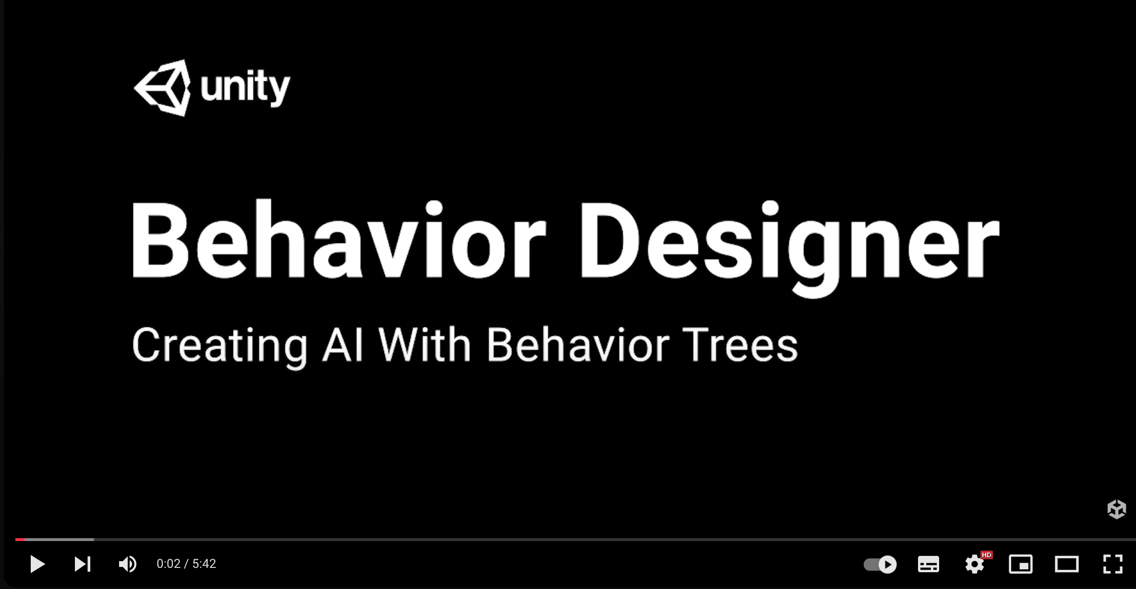
Enemy AI: Making it Believable
Behavior Trees with Behavior Designer
References: https://www.youtube.com/watch?v=T_of4_jRoJA

Slide 14
Unity Sentis
The power of AI in your Unity game or app
Sentis brings the rapid pace of AI model innovation into game development. Import your model via the ONNX file standard, create new gameplay experiences, and publish on all Unity-supported devices.
Unity Sentis is a neural network inference library that allows you to run AI models directly within the Unity engine. This enables developers to create more intelligent and interactive game experiences by integrating AI capabilities into their games.
References: https://unity.com/products/sentis

Slide 15
Unity Sentis
Use Cases of Unity Sentis:
AI-Powered NPCs: Create more realistic and engaging non-player characters.
Procedural Content Generation: Generate levels, environments, or items.
Real-time Object Detection and Classification: Identify objects in the game world.
Natural Language Processing: Enable voice commands and text-based interactions.
Advanced Game Mechanics: Implement complex AI behaviors, such as strategic decision-making.
References: https://unity.com/products/sentis

Slide 16
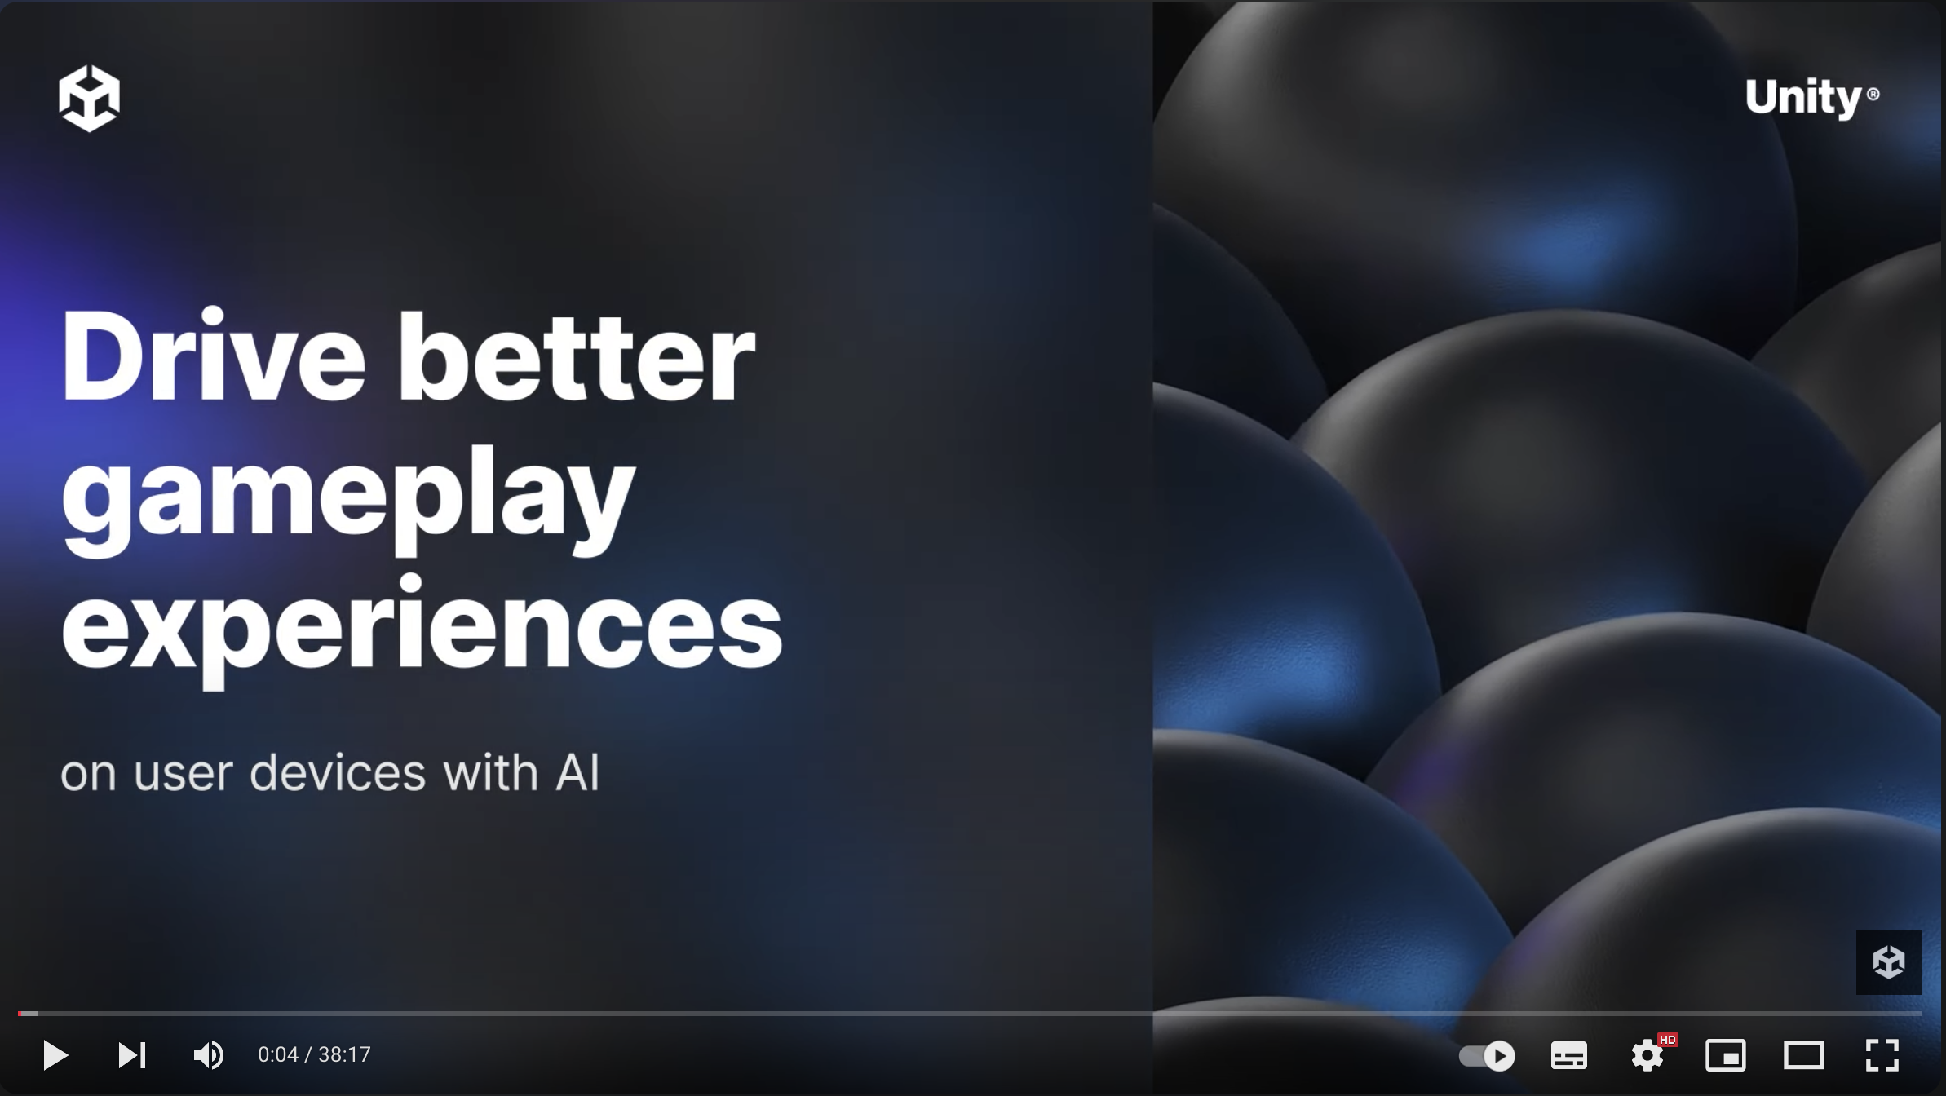
Unity Sentis
Drive better gameplay experiences on user devices with AI | GDC 2024
References: https://www.youtube.com/watch?v=7uU_TxSyINI

Slide 17
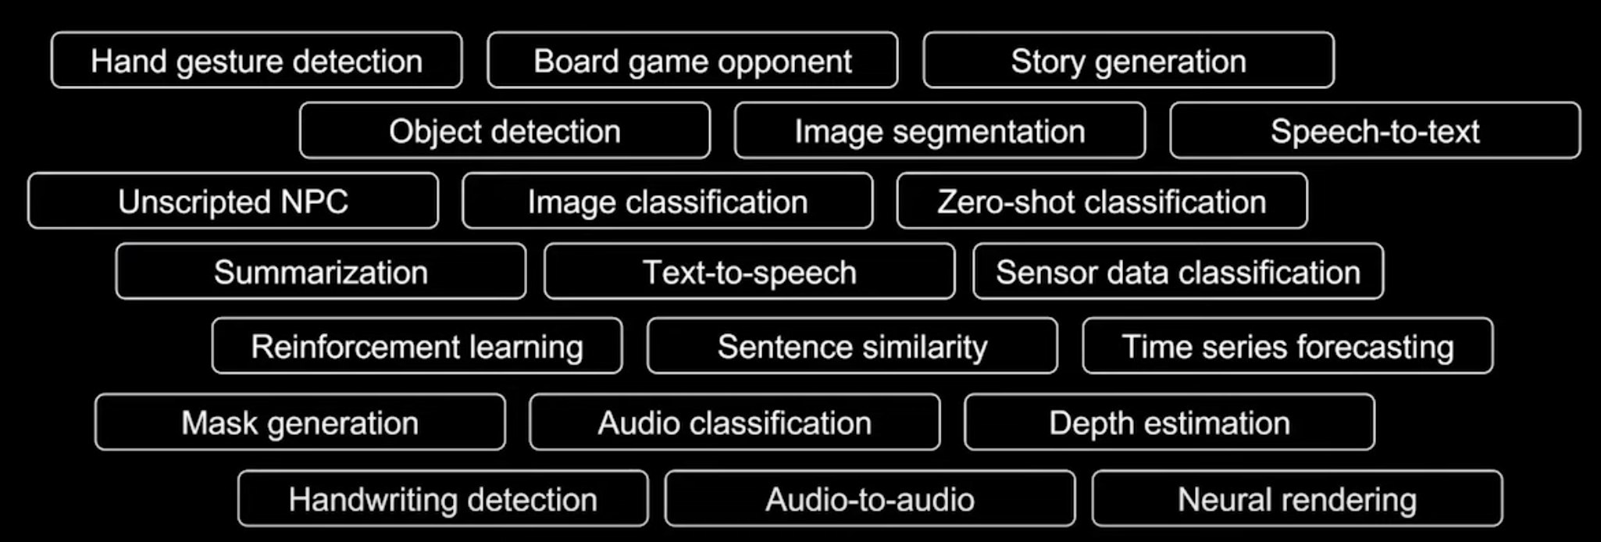
Unity Sentis
Use Cases of Unity Sentis:
References: https://unity.com/products/sentis

Slide 18
Summary
Understand the concept of AI in games
Apply AI techniques to create intelligent NPCs
Implement basic AI behaviors like patrolling, chasing, and attacking.
Utilize Finite State Machines (FSMs) to control NPC behavior.

